Slide 1
Effects of Media on child development
PROFESOR DATIN DR MARIANI MD NOR
FAKULTI PENDIDIKAN
UNIVERSITI MALAYA

Slide 2
Objectives
Introduction
To understand the different kinds of media.
To analyse the impact of media on various aspects of
development.
To identify positive and negative impact of media on children.
Parental influence in children media influence.
How to incorporate good mass media habits in children.

Slide 3
Introduction
Extreme caution in the choices we make for our children to
develop skill, habits and moral and social values to grow up to
be good human beings.
Understand the background to understand the impact.
Getting a perspective in how we can influence good media habits for appropriate child development.

Slide 4


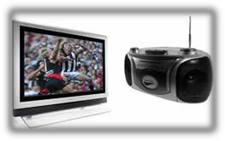


DIFFERENT KINDS OF MEDIA
Print Media
Electronic Media
New Age Media

Slide 5

IMPACT OF MEDIA ON VARIOUS ASPECTS OF DEVELOPMENT
It is crucial to understand how media impacts a child development to be able to control the impact, at various developmental aspects and how media effects each area of development.
the psychological changes a child goes through due to the impact of media.

Slide 6
IMPACT OF MEDIA ON VARIOUS ASPECTS OF DEVELOPMENT
Cognitive Development
This is the child's ability to learn and solve problems.
For example, this includes a two-month-old baby learning to explore the environment with hands or eyes or a five-year-old learning how to do simple math problems.
Social and Emotional Development
This is the child's ability to interact with others, including helping themselves and self-control.
Examples of this type of development would include: a six-week-old baby smiling, a ten-month-old baby waving bye-bye, or a five-year-old boy knowing how to take turns in games at school.

Slide 7
IMPACT OF MEDIA ON VARIOUS ASPECTS OF DEVELOPMENT
Speech and Language Development
This is the child's ability to both understand and use language.
For example, this includes a 12-month-old baby saying his first words, a two-year-old naming parts of her body, or a five-year-old learning to say "feet" instead of "foots".
Fine Motor Skill Development
This is the child's ability to use small muscles, specifically their hands and fingers, to pick up small objects, hold a spoon, turn pages in a book, or use a crayon to draw.
Gross Motor Skill Development
This is the child's ability to use large muscles.
For example, a six- month-old baby learns how to sit up with some support, a 12-month-old baby learns to pull up to a stand holding onto furniture, and a five-year- old learns to skip.

Slide 8
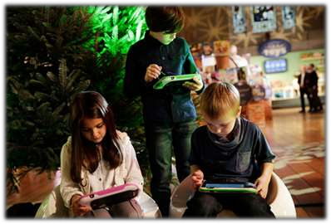
Media impact on Emotional and Social Development
IMPACT OF MEDIA ON VARIOUS ASPECTS OF DEVELOPMENT
Children at an infant stage do not understand emotions or social behaviour.
Surrounding environment determines the perception of a set emotional reaction and social interaction.
Type of content children are exposed to makes a difference.
Children in non social, instead of social and physically active state, due to Mass Media.

Slide 9
Media Fear and Anxiety
IMPACT OF MEDIA ON VARIOUS ASPECTS OF DEVELOPMENT
Children can not only witness and share emotions experienced by media characters, but also respond directly to emotionally charged events depicted in the media.
Monster House, Corpse Bride, and Harry Potter and the Order of the Phoenix are just a few examples of horror-filled content that is targeted to children.
Classic Disney films such as Bambi, and The Lion King can also be upsetting to very young children.

Slide 10
Long Term Fears and Phobias
IMPACT OF MEDIA ON VARIOUS ASPECTS OF DEVELOPMENT
Watching more than six hours of television a day put children at greater risk for scoring in the clinical range of these trauma symptoms.
A survey of nearly 500 parents of elementary school children found that the children who watched television just before bedtime had greater difficulty falling asleep, were more anxious at bedtime, and had higher rates of nightmares.

Slide 11

IMPACT OF MEDIA ON VARIOUS ASPECTS OF DEVELOPMENT
Preschoolers and younger elementary school children (two to seven years of age) are most frightened by characters and events that look or sound scary.
This pattern is consistent with younger children's perceptual dependence, their tendency to fixate on visual and auditory cues rather than more conceptual information such as the motives of a character.

Slide 12
IMPACT OF MEDIA ON VARIOUS ASPECTS OF DEVELOPMENT
Older elementary school children (eight to twelve years of age) are frightened more by scenes involving injury, violence, and personal harm.
Older children also are more responsive than younger children are to events in the media that seem realistic or could happen in real life.
This heightened responsiveness is consistent with their more mature understanding of the distinction between fantasy and reality.
Several studies have found, for example, that older children or teens (age eight to twelve) are more frightened by television news than are younger children.

Slide 13
Media and Moral Development
IMPACT OF MEDIA ON VARIOUS ASPECTS OF DEVELOPMENT
Moral development in children follows a predictable developmental path.
Moral reasoning becomes more flexible and “other” oriented.
Extensive viewing of television violence can alter children's views about the acceptability of violence and perhaps even hinder the development of their moral reasoning.
Cheating, lying, stealing, yelling, cursing can be perceived as acceptable behaviour by children.
Media can cause confused moral reasoning.
Some programs and genres can enhance moral development.

Slide 14
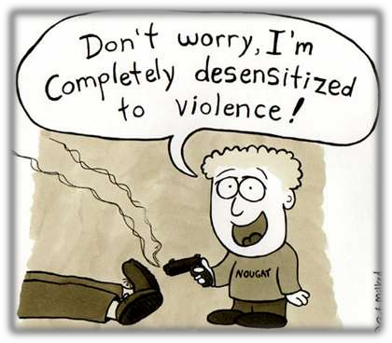
Media and Antisocial Behavior
IMPACT OF MEDIA ON VARIOUS ASPECTS OF DEVELOPMENT
On an average a child views 200,000 violent acts on television by the age of 18.
Kids become desensitized to
violence and more aggressive.
Violence is often promoted as a fun and effective way to get what you want.

Slide 15
IMPACT OF MEDIA ON VARIOUS ASPECTS OF DEVELOPMENT
Media and Antisocial Behavior
Many violent act are perpetrated by the “good guys” whom kids have been taught to admire.
Even though kids are taught by their parents that it's not right to hit, television says it's OK to bite, hit, or kick if you're the good guy. This can lead to confusion when kids try to understand the difference between right and wrong.

Slide 16
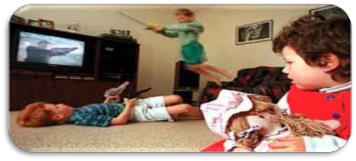
Media and Antisocial Behavior
IMPACT OF MEDIA ON VARIOUS ASPECTS OF DEVELOPMENT
Behaviour problems, nightmares, and difficulty sleeping may follow exposure to media violence.
Young kids are particularly frightened by scary and violent images.
Simply telling kids that those images aren't real won't console them, because they can't yet distinguish between fantasy and reality.

Slide 17
Media and Antisocial Behavior
IMPACT OF MEDIA ON VARIOUS ASPECTS OF DEVELOPMENT
Violent television programming contributes to both short- term and long-term increases in children's aggressive behaviour.
Video games act as fantasy violence.
Exposure to violent media results in Risky behaviour.

Slide 18
Risky Behaviour
IMPACT OF MEDIA ON VARIOUS ASPECTS OF DEVELOPMENT
Smoking
Drinking
Drugs
Ragging
Eve teasing
Sexual acts
Grooming
Driving
Fighting
Language
Emotions
Aggression
Copy cats
Health

Slide 19
POSITIVE AND NEGATIVE IMPACT OF MEDIA ON CHILDREN
Positive | Negative
Increase in academic and social skills/exposure | Risky behaviour
Children viewing educational programming have higher grades. Improves reading writing grasping. Audio and visual learning. | Phobias and fears
Certain programmes are prepared for children for real life situations. Understanding the world around us. | Obesity, lack of physical activities
Helps develop skills like critical thinking, writing, public speaking, imagination and creativity | Inappropriate language and manners
Develops gross motor skills. Video games help enhance gross motor skills. | Aggressive behaviour lack of actual real experiences

Slide 20
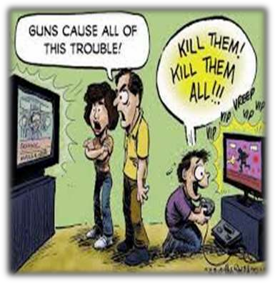
PARENTAL INFLUENCE IN CHILDREN MEDIA INFLUENCE
Parents play a key role in how media
affects children.
Your choices matter.
Media is not just entertainment but a vast source of information.
Guidance and reinforcement of
messages in differed portrayals can
enhance the child’s pro social Learning
Be the boss
Helping children understand the
Content.

Slide 21
The art of incorporating good strategy
HOW TO INCORPORATE GOOD MASS MEDIA HABITS IN CHILDREN
Constant monitoring – Monitoring the quality of media that your child is exposed to is crucial. Avoid exposing children to violent Aggressive, scary, emotionally disturbing and any such other inappropriate media.
Rating - Keep a check on the media rating to ensure children are exposed to media which is age appropriate.
Guidance – When there is proper guidance and explanation to an action the child will be able to understand the messages better.
Be a role model – Children learn from their surroundings and people close to them. Especially parents.

Slide 22
The art of incorporating good strategy
Make rule and stick to them – As parents putting your foot down will only help your child’s development. Do not compromise on that. Stick to the rules.
Choose wisely – Depending on the development stage of your child choose media exposure that will help the developmental aspects of your Child. For example: Sesame street, Barney, Blue etc are series that are Educative and fun for children.
Screen time – Children need both physical and mental activities for appropriate development. Limit screen time. Another way of diverting children from media to productive activities is by letting them earn the screen time.

Slide 23
The art of incorporating good strategy
Respect for Technology – With ipods and tabs its not possible to keep kids away from technology however it can be control and directed to positive development.
Restricted viewing – Put a child lock on the channels you think inappropriate for your child.
Reality from Fantasy – Superman flies, spider man climbs walls and Amir Khan can ride a bike on anything even water and wire. A child does not understand the real message and emotion in all given instances. Explaining and even showing real from fake and fantasy helps the child understand the messages better.

Slide 24
The art of incorporating good strategy
Communication – Communicating with your child helps you understand what understanding they develop from certain media exposure which will help you guide them better.
Do not use high-tech devices as Babysitters – With more nuclear families today is understandable that stress gets to us. However in no given situation should a tech device be used as a babysitter.
Creative and educational development - With exposure to so many
avenues through media a positive direction will go a long way. Find what interests your child and develop on that through media and internet. If your child is inquisitive you can look up appropriate educative video on the internet. You can use internet to assist with homework or questions the child is inquisitive about.

Slide 25
The art of incorporating good strategy
Family time – Media can be very effectively used for quality family time as well. It can be used to have encouraging discussion and sharing of knowledge and views. One can use this time to educate the child about the cons of media and how to use media effectively instead of being overwhelmed by it.

Slide 26
Summary
To sum it up Media has both positive and negative
implication on children.
These cannot be eradicated however we can
definitely ensure that we encourage the positive
aspects and control the negative for our children
to understand and use the resources available for
growth and not destruction of self being.

